Slide 1
What am I building? What is the goal?

Slide 3
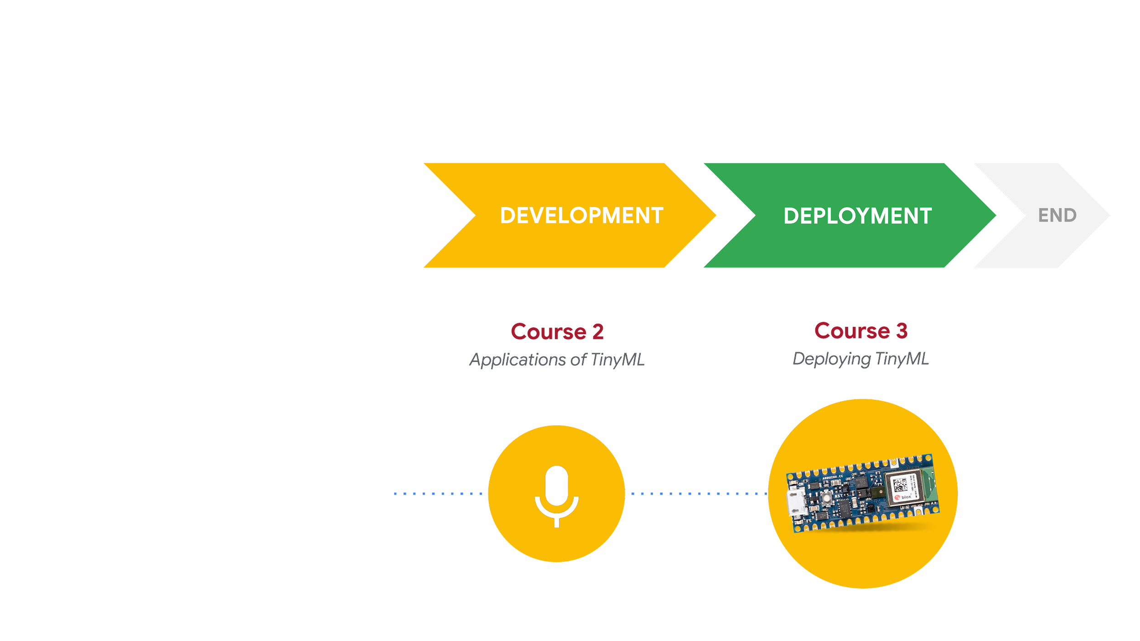
Responsible AI: Human-Centered Design
DESIGN
START
Course 1
Fundamentals of TinyML
What am I building?
Who am I building
this for?
What are the consequences for
the user if it fails?
Notes:
Remind students about ‘design’ phase of HCD framework and why it’s important to incorporate ethics into this phase

Slide 4
“
Machine intelligence is the last invention that humanity will ever need to make
”
Nick Bostrom
Philosopher, University of Oxford
Source: “What happens when our computers get smarter than we are?" TED Talk, March 2015.
Notes:
The hype surrounding AI is at an all-time high
First step in responsible design is making sure we choose the right solution for the problem
But AI is not always the answer

Slide 5
AI is not always the best solution!

Slide 6
What am I building?
Which one should we choose?
Traditional
Programming
Machine
Learning
🧐
Notes:
Compare ML vs traditional programming - in C. 2.1 students learn the differences between them in terms of how they function
Now, we’re going to take a closer look at each. Once we understand the pros and cons of each, we can make a more informed choice about when to use ML

Slide 7

Traditional Programming
Pros
Quicker to build
Easier to explain
Easier to debug
Easier to maintain
More consistent/stable
Cons
Does not scale
Does not adapt to changes
Does not work for complex tasks
if (speed < 4) {
status = WALKING;
}
Notes:
Often a rule or heuristic-based solution will work just as well, if not better, than an AI version.
"Rules-based systems are best suited to situations in which there are lower volumes of data and the rules are relatively simple," Grisenthwaite said. "Many companies use rules-based systems for expense approvals, defining the dollar thresholds that require management approvals at various levels."
https://commons.wikimedia.org/wiki/File:Emoji_u1f6b6_1f3fd_200d_2640.svg

Slide 8
Machine Learning
Pros
Complex problems
Scale
Adaptable
Personalization
Improves over time
Cons
Slower to build
Harder to explain/interpret
Harder to debug
0101001010100101010
1001010101001011101
0100101010010101001
0101001010100101010
Label = WALKING
Notes:
https://commons.wikimedia.org/wiki/File:Emoji_u1f6b6_1f3fd_200d_2640.svg

Slide 9
What is the goal?
1
2
3
4
What is the problem?
Why does the problem need to be solved?
How could the problem be solved manually?
Will AI offer unique value?
Notes:
https://pair.withgoogle.com/chapter/user-needs/
Step 1: What is the problem? Describe the problem informally and formally and list assumptions and similar problems.
Step 2: Why does the problem need to be solved? List your motivation for solving the problem, the benefits a solution provides and how the solution will be used.
Step 3: How would I solve the problem? Describe how the problem would be solved manually to flush domain knowledge.
https://machinelearningmastery.com/process-for-working-through-machine-learning-problems/

Slide 10
Case Study: Diabetic Retinopathy
What is the problem?
Why does the problem need to be solved?
How could the problem be solved manually?
Will AI offer unique value?
Early identification of DR progression from color fundus photographs
Notes:
https://pair.withgoogle.com/chapter/user-needs/
Step 1: What is the problem? Describe the problem informally and formally and list assumptions and similar problems.
Step 2: Why does the problem need to be solved? List your motivation for solving the problem, the benefits a solution provides and how the solution will be used.
Step 3: How would I solve the problem? Describe how the problem would be solved manually to flush domain knowledge.
https://machinelearningmastery.com/process-for-working-through-machine-learning-problems/

Slide 11
Case Study: Diabetic Retinopathy
What is the problem?
Why does the problem need to be solved?
How could the problem be solved manually?
Will AI offer unique value?
DR is reaching epidemic proportions, and if people were able to access earlier diagnosis this would allow for intervention and prevention of further DR progression
Notes:
https://pair.withgoogle.com/chapter/user-needs/
Step 1: What is the problem? Describe the problem informally and formally and list assumptions and similar problems.
Step 2: Why does the problem need to be solved? List your motivation for solving the problem, the benefits a solution provides and how the solution will be used.
Step 3: How would I solve the problem? Describe how the problem would be solved manually to flush domain knowledge.
https://machinelearningmastery.com/process-for-working-through-machine-learning-problems/

Slide 12
Case Study: Diabetic Retinopathy
What is the problem?
Why does the problem need to be solved?
How could the problem be solved manually?
Will AI offer unique value?
Collect data from retina specialists or trained graders, write rules based on presence of hemorrhages and microaneurysms
Notes:
https://pair.withgoogle.com/chapter/user-needs/
Step 1: What is the problem? Describe the problem informally and formally and list assumptions and similar problems.
Step 2: Why does the problem need to be solved? List your motivation for solving the problem, the benefits a solution provides and how the solution will be used.
Step 3: How would I solve the problem? Describe how the problem would be solved manually to flush domain knowledge.
https://machinelearningmastery.com/process-for-working-through-machine-learning-problems/

Slide 13
Case Study: Diabetic Retinopathy
What is the problem?
Why does the problem need to be solved?
How could the problem be solved manually?
Will AI offer unique value?
Machine learning can improve predictions about the progression of DR for individual patients and identify patterns in images that were previously unrecognized by experts
Notes:
https://pair.withgoogle.com/chapter/user-needs/
Step 1: What is the problem? Describe the problem informally and formally and list assumptions and similar problems.
Step 2: Why does the problem need to be solved? List your motivation for solving the problem, the benefits a solution provides and how the solution will be used.
Step 3: How would I solve the problem? Describe how the problem would be solved manually to flush domain knowledge.
https://machinelearningmastery.com/process-for-working-through-machine-learning-problems/

Slide 14
Defining goals for positive social impact
AI for Social Good
Using artificial intelligence (AI) and machine learning (ML) to help address the world’s most pressing challenges
Notes:
Current state of affairs
overview of company initiatives, funding, publications/conferences,
some show exciting examples
Meanwhile, in the past decade, an emerging theme in the AI research community is the so-called “AI for social good” (AI4SG): researchers aim at developing AI methods and tools to address problems at the societal level and improve the well-being of the society. Over the years, there have been several suc- cessful AI4SG projects, such as guiding municipal water pipe replacement [8], protecting wildlife from poaching [9], and spreading HIV prevention information among homeless youth [10]. AI4SG has received recognition from both within and outside the academic community. Major AI conferences have featured various special tracks and workshops dedicated to AI4SG, with over 1000 papers on AI4SG topics formally published. Large companies are expanding their investments on AI4SG initiatives.
https://www.mckinsey.com/featured-insights/artificial-intelligence/applying-artificial-intelligence-for-social-good
https://hai.stanford.edu/blog/ai-social-good-how-one-nonprofit-hopes-solve-global-health-challenges

Slide 15

How can we design AI for social good?
There are 17 goals on the United Nations’ 2030 Agenda for Sustainable development, for example:
Ending poverty and world hunger
Improving health and education
Reducing inequality and injustice
Notes:
The 2030 Agenda for Sustainable Development, adopted by all United Nations Member States in 2015, provides a shared blueprint for peace and prosperity for people and the planet, now and into the future. At its heart are the 17 Sustainable Development Goals (SDGs), which are an urgent call for action by all countries - developed and developing - in a global partnership. They recognize that ending poverty and other deprivations must go hand-in-hand with strategies that improve health and education, reduce inequality, and spur economic growth – all while tackling climate change and working to preserve our oceans and forests.
https://sdgs.un.org/goals

Slide 16

Challenges facing AI4SG
Learning from limited data
Geographical imbalances
Biased data
Learning with limited memory and computation
Notes:
https://arxiv.org/pdf/2001.01818.pdf

Slide 17
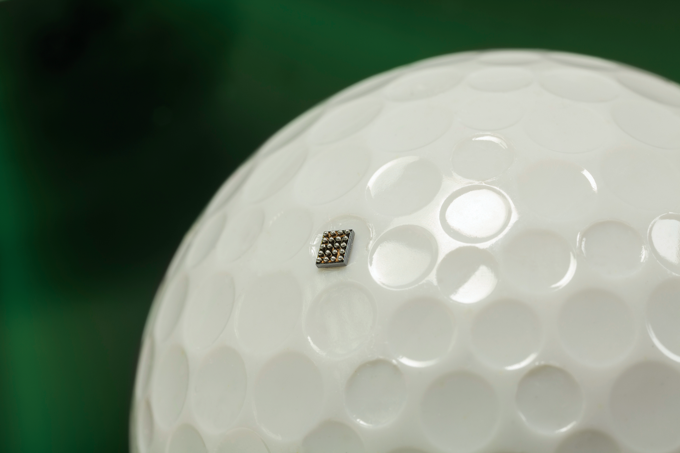
Window of Opportunity with TinyML
Learning with limited memory
and computation
Battery-operated
On-device computing
Low latency
Low cost
Small size

